Slide 1
AWS Cloud Fundamentals
Kerry Nakayama

Slide 2
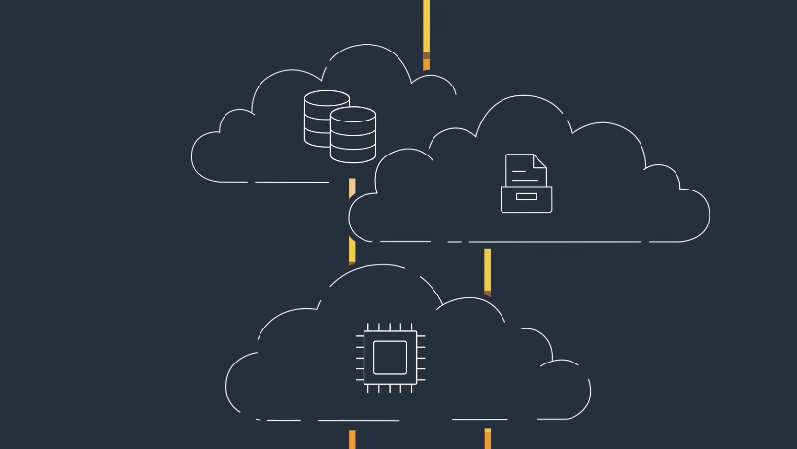
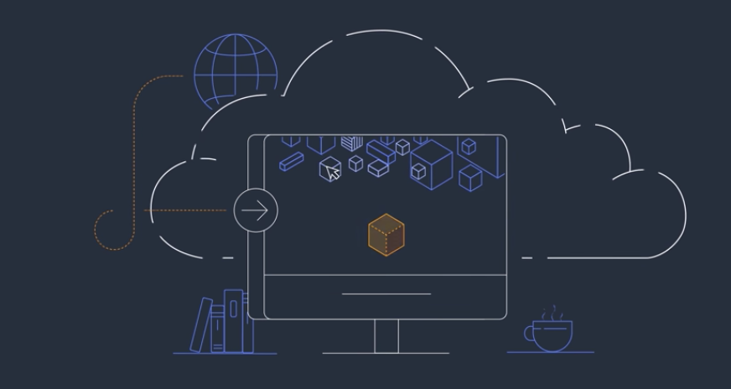
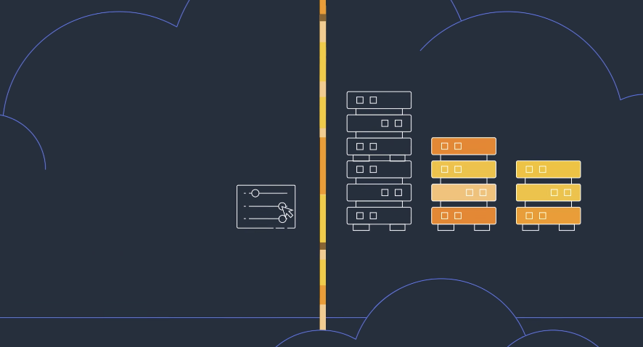
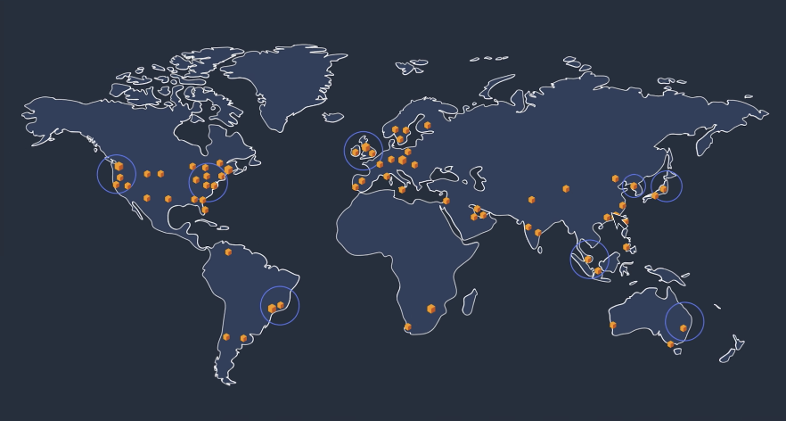
What is Cloud Computing
Cloud computing is the on-demand delivery of IT resources over the Internet with pay-as-you-go pricing
No need for physical data centers or servers
Access on an as-needed basis
Notes:
Basically someone else deals with the data centers and servers
You pay a subscription service fee rather then the cost of ownership - since data is ever changing
Benefits – Agility, Elasticity, Cost saving (use as you need), deploy internationally (servers all over the world reduce latency)
Infrastructure as a service – networking features , computers and data storage space
Platform as a service - removes managing underlying infrastructure
Software as a service – product that is run and managed by service provider
Snowflake

Slide 3
AWS Regions
AWS serves over a million active customers in more than 190 countries
An AWS Region is a physical location in the world where AWS has multiple Availability Zones
AWS provides you with the flexibility to place instances and store data within multiple geographic regions
Notes:
Each Amazon Region is designed to be completely isolated from the other Amazon Regions. This achieves the greatest possible fault tolerance and stability
Each Availability Zone is designed as an independent failure zone. This means that Availability Zones are physically separated within a typical metropolitan region and are located in lower risk flood plains (specific flood zone categorization varies by AWS Region)
In addition to discrete uninterruptable power supply (UPS) and onsite backup generation facilities, they are each fed via different grids from independent utilities to further reduce single points of failure. Availability Zones are all redundantly connected to multiple tier-1 transit providers

Slide 4
IAM User and Permissions
You can use AWS Identity and Access Management (IAM) roles to grant access to databases among other items

Slide 5
Creating and Managing Virtual Machines with EC2
An Amazon Machine Image (AMI) may be used for this. EC2 instances created from AWS AMIs have the AWS CLI tools preinstalled

Slide 6
Server vs Serverless Architecture
Server | Serverless
Predictive tasks: For tasks that use constant or predictive compute, it may be more cost-effective to use server-based billing | Server management: Because there is no backend infrastructure to be responsible for, liability is reduced and there is no system administration
Testing and debugging: Debugging is less complicated because there is visibility into backend processes and the application is not broken up into separate, smaller functions | Scalability: With a serverless architecture, you don’t have to think twice about provisioning infrastructure because of its ability to automatically scale with traffic volumes
Overall control: The company owns and manages the infrastructure, which provides full control over all aspects of the application | Application flexibility: You can migrate individual application features or partial workloads to run on serverless as on-demand events
Compliance and security: Having full control over the infrastructure allows for full visibility, which may be required for compliance and security standards | Cost: The cost of hiring backend infrastructure engineers goes down, along with operational costs
Legacy applications: Existing applications may not have the flexibility of decoupling individual parts and may be better suited to migrate to a server-based architecture | Startup friendly: The serverless architecture pay-as-you-go model allows you to build an environment nearly for free and ease into the market without dealing with huge bills for minimum traffic

Slide 7
Provisions

Slide 8
Networking (Virtual Private Cloud)

Slide 9
Storage

Slide 10
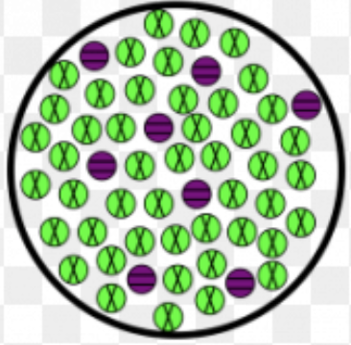
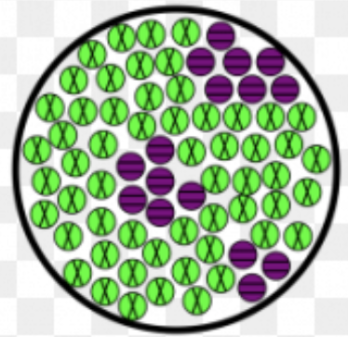
Moving Data in the Cloud
Homogeneous migrations, where you migrate between same database engines, may require the use of native database tools to migrate database elements
Heterogenous migrations, where you migrate between different database engines, require the use of the Schema Conversion Tool to first translate your database schema to the new platform
Notes:
Identifies the issues, limitations, and actions for the schema conversion
Generates the target schema scripts, including foreign keys and constraints
Converts code such as procedures and views from source to target and applies the code on the target.

Slide 11
Transforming Data

Slide 12
Traditional vs Cloud Data Warehousing

Slide 13
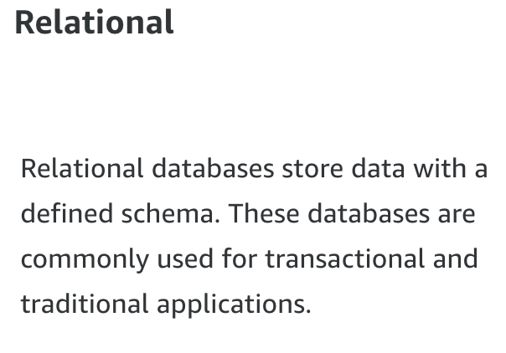
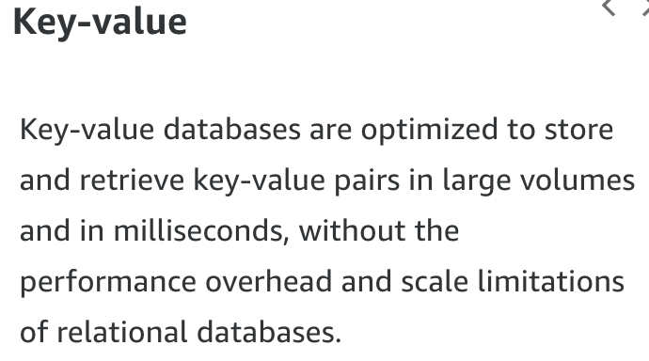
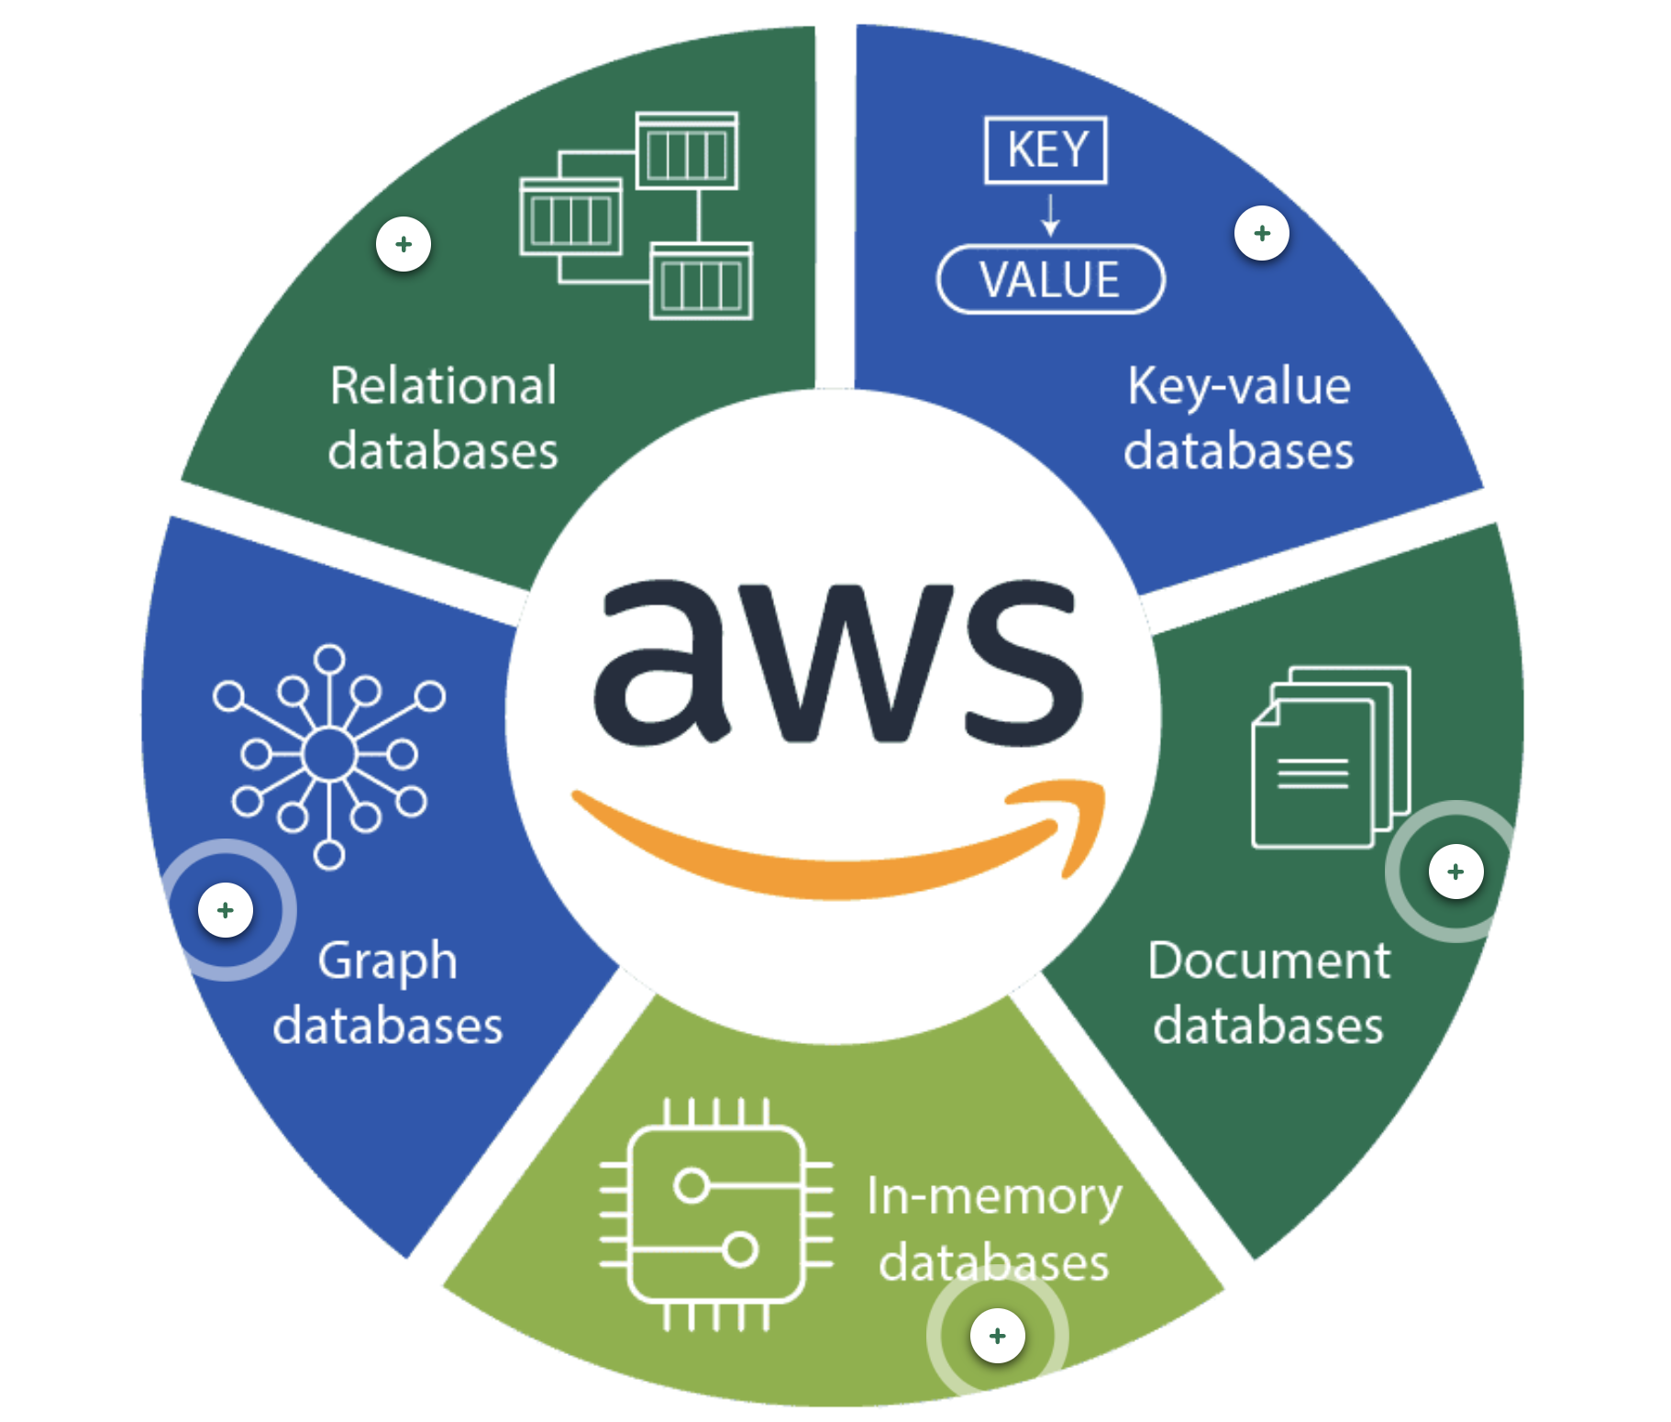
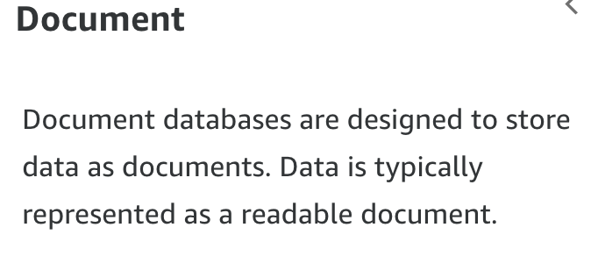
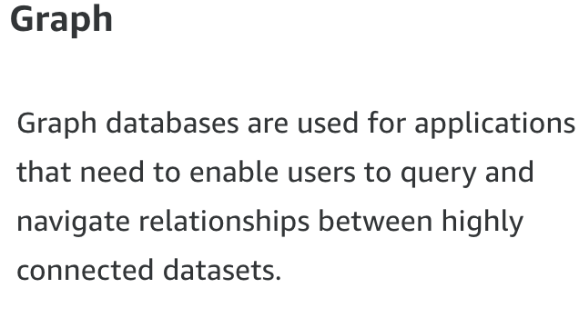
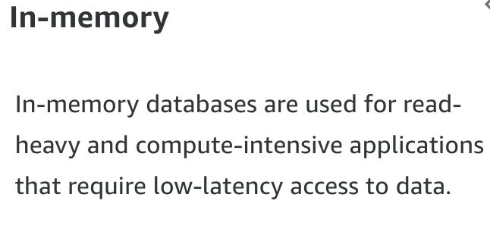

Slide 14

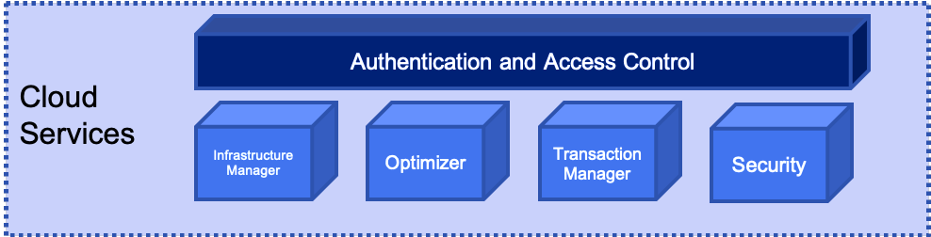
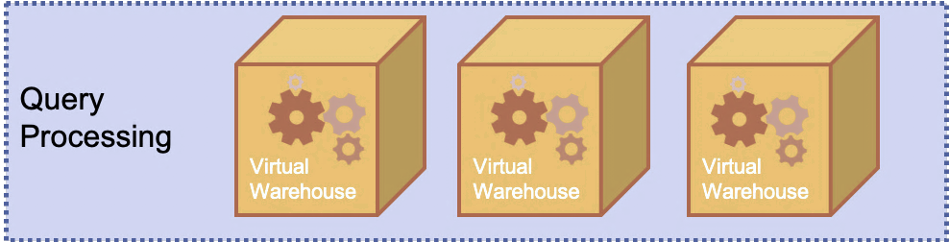
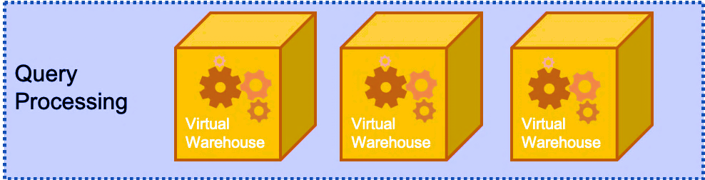
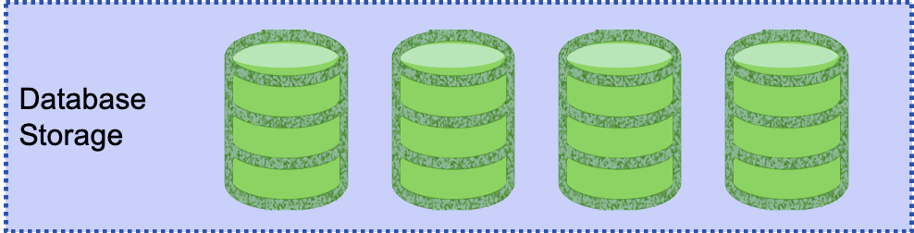
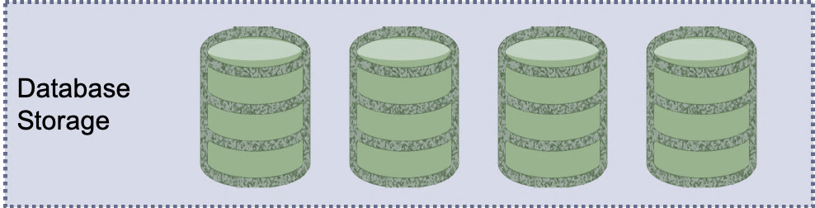
Snowflake is a hybrid of Shared Nothing and Disk
So how does Snowflake address these shortcomings?
Snowflake is Elastic!
Notes:
The idea here is that by using the cloud based infrastructure SNOWFLAKE can essentially throw resources at the management of shared-nothing infrastructure indefinitely.
This is because Snowflake is elastic in nature- it will expand as resources are required and contract when not required.
This addresses both the high compute requirements of Shared Nothing AND the high-cost requirements of creating “workers”

Slide 15
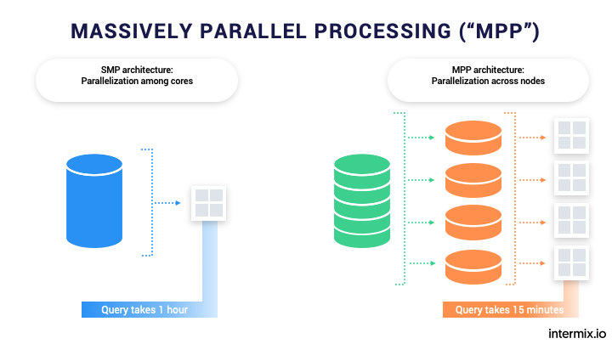
Massive Parallel Processing
Snowflake is a shared-nothing or massive parallel processing system.
Imagine if you will, for a minute, a series of workers, each of whom have their own memory, resources, and processors assigned to a task.
We can split the task among these workers thereby speeding up the task immeasurably.
“MPP is the coordinated processing of a program by multiple processors that work on different parts of the program, with each processor using its own operating system and memory”

Slide 16
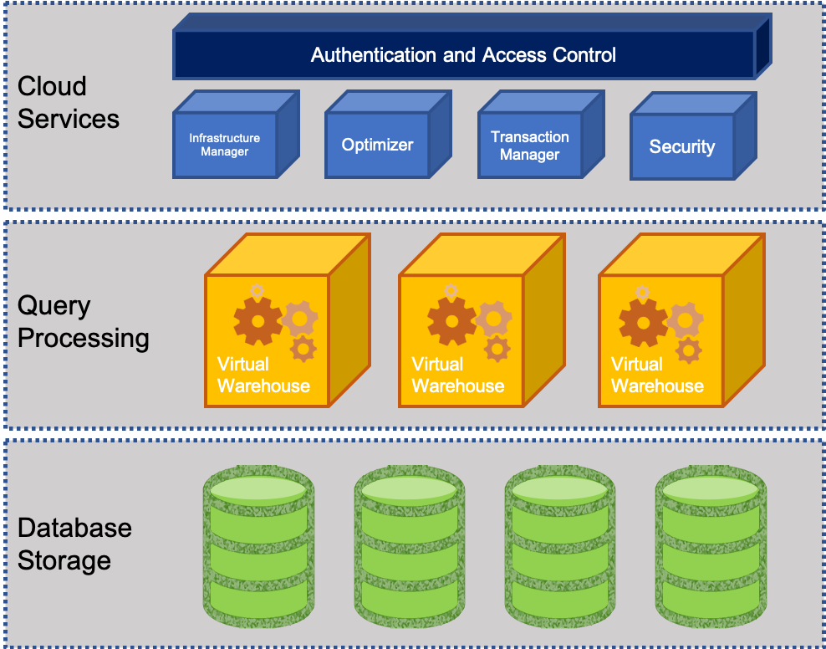
What does Snowflake offer?
Let’s divide data warehouses into three parts:
Storage: for storing data and
Computing: which is what allows us to do all the things we do in structured SQL databases
Services: Which are some of the things like pipelines, etc.
Snowflake offers us the opportunity to independently scale the storage, services, and the computing. Why is this important?

Slide 17
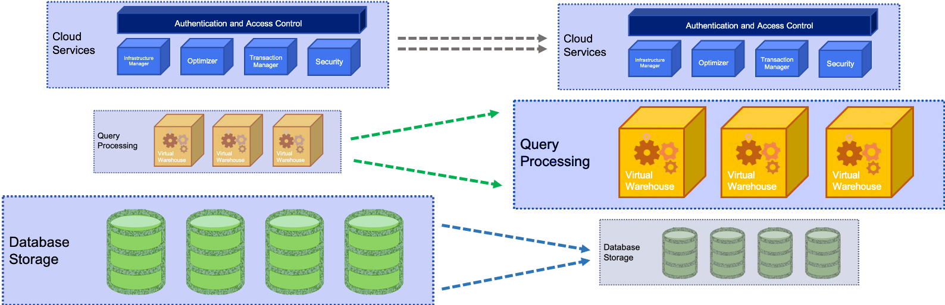
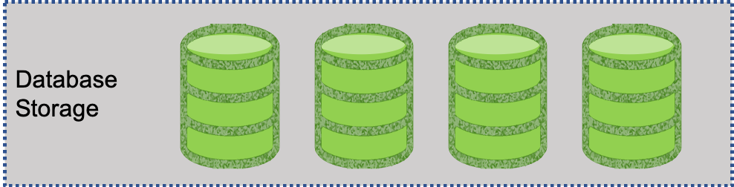
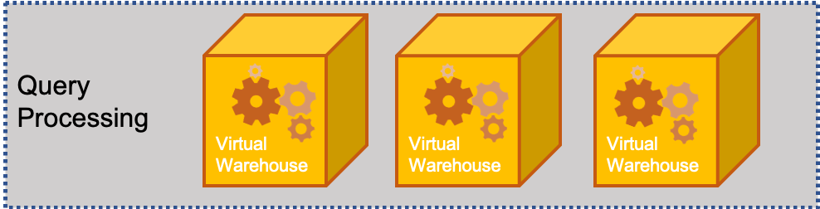
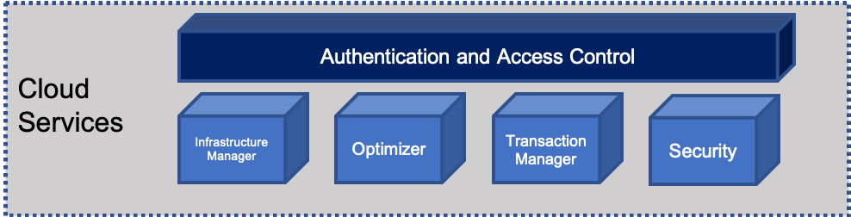
Snowflake Elasticity
Snowflake has a novel concept to deal with elasticity:
This means that we can deal with the DATA STORAGE, COMPUTE and USERS (Services) layer without effecting the other ones
DATA
Services
Compute
Notes:
By isolating each layer they can expand and contract independently of each other.
This means that we can deal with the DATA STORAGE, COMPUTE and USERS (Services) layer without effecting the other ones.
Let’s go into each of these
DATA - The amount of data stored can be increased or decreased at any time.
- Data and compute decoupled – is determined independently of the volume of data in the system
- store data at a very low cost because no compute resources are required to store data in the database
COMPUTE – these resources that are being used for query processing can also be scaled up or down depending on the intensity of the workload on the system changes.
- remember - storage and compute are decoupled,
- data is dynamically distributed
- changing compute resources does not require reshuffling the data
- Compute resources can be changed on-the-fly, without disruption.
SERVICES – with other systems as more users come on the the resources are strained and everything becomes much slower
- other system solution is to create a new datamart
- extra management burden
- replicating and/or migrating data across systems
- Snowflake can scale to support more users and workloads without performance impact because multiple virtual warehouses can be deployed on-demand, all with access to the same data.

Slide 18

Snowflake Automation
Data distribution:
Managed automatically by Snowflake based on usage.
Snowflake automatically manages how data is distributed in the virtual warehouse
Other systems rely on a static partitioning scheme based on a distribution algorithm or key chosen by the user at load time
Data is automatically redistributed based on usage to minimize data shuffling and maximize performance.
Loading Data:
Complex ETL data pipelines are no longer needed to prepare data for loading. Snowflake natively supports and optimizes diverse data, both structured and semi-structured, while making that data accessible via SQL.

Slide 19

Confused? ASK QUESTIONS

Slide 20
Break & Lab2
Notes:
Take a data set how would you set up the Schemas

